Slide 1

ADI x AuxoAI: Agentic AI Proposal
April 2025

Slide 2
Agenda
UDA SCOPE
POTENTIAL AGENTIC INTERVENTIONS
EXECUTION PLAN
DELIVERY POD
2

Slide 3
UDA Scope – Focus Area for next 4 Weeks
Tool | Activity | Priority | Estimated Effort
Fivetran | Housekeeping and cleanup of Fivetran sync/pipelines and files in ADLS | High | 3 days
Astronomer | Housekeeping and cleanup of Astronomer objects in Astro UI and GIt repo | High | 3 days
Astronomer | Automated monitoring and alerts through Astronomer for Fivetran sync | Medium | 2 weeks
DBT | Astronomer activities – Schedule an email through Astro for the Inactive Users of dbt | High | 1 day
DBT | Mandatory tests for each Model – System dates check to be enabled for all the models in the project | High | 2-3 days
DBT | Key pair for the service accounts for deployments | High | 1 week
DBT | Python Model – dbt modeling using Python | Medium | 1 week
DBT | audit logs – Change the schema of the dbt audit logs that are generated | Medium | 2-3 days
Snowflake | Manufacturing Use cases - EMA, ESL applications support, Central AI - Support team's use cases | High | N/A
Snowflake | Backlog items - Falcon reference clean up - Documentation, Snowflake Object cleanup | Medium | 2 weeks
Snowflake | Productionize the Solution for MFG IFF Parser | Medium | 3 weeks

Slide 4

Unified Self-Service through Multi-Agent Orchestration
Unified Self-Service through Multi-Agent Orchestration
One conversation-driven platform uniting ingestion, transformation, governance, and analytics
No specialized technical skill required—speeding time-to-insight and empowering everyone to become data-savvy
Multi-Agent Orchestration
Intelligent Data Ingestion Agent
Smart Transformation Agent
Intelligent Analytics Assistant Agent
Smart Health Monitor Agent
Smart Governance Agent
Converse With Data
Enables AI based data ingestion through NLU, source connectivity, schema detection, and ingestion scheduling
Integrates with Fivetran, etc for intelligent, context-aware data ingestion
Applies dbt-style transformations to prepare analytics-ready datasets
Integrates with dbt for smart modeling, performance tuning, and lineage tracking
Integrates with Dataiku and Snowflake to support self-service analytics
AI-based insights and text-to-SQL capabilities for ad-hoc analysis.
AI based platform monitoring, performance and data pipeline health
Interfaces with Datadog for real-time observability and alert
Ensure optimized performance and cost
Intelligent data cataloging, smart access control, and robust compliance automation
Leverages Atlan/ Immuta for intelligent data governance
Enables users to query data using plain English via automatic SQL generation, execution and dashboards
Simplifies data access for non-technical users through text-to-SQL capabilities through DV
Natural Language Portal
Users describe goals in plain English, and the portal’s AI intelligently interprets and orchestrates tasks across data services

Slide 5
Where do the Agents lie across the Data SDLC
Illustrative Use Case
1
Intelligent Data Ingestion Agent (IDIA)
Smart Transformation Agent (STA)
Intelligent Analytics Assistant Agent (IAAA)
Discussion with business stakeholders
2
3
Document Business Requirements
Exploratory Data Analyses / Hypotheses Testing
Document Functional Requirements
Design the technical architecture
Write the code to ingest data
BI Report & Dashboard development
Validate and gather business signoff
Design data exchange protocols (e.g., API, Read from DB or IP)
Validate and iterate the code to make it effective
AI Model Training and Validation
Business & Functional Requirements
Solution Design & Architecture
Data Ingestion / Transformation
Analytics & AI Product Build
Data & Technical Requirements
Data Modeling
Data Product Build
Deployment & Operations
Document detailed data requirements
Identify detailed data sources
Write the code to create a data product
Code Checkin
Detailed technical requirements
Conduct Data profiling
Validate and iterate the code
CICD Pipeline Deployment
Validate and gather signoffs
Design the Target data model
Periodic Refresh and Monitoring
Develop source to target mapping
Smart Health Monitor Agent (SHMA)
Smart Governance Agent (SGA)
4
5

Slide 6
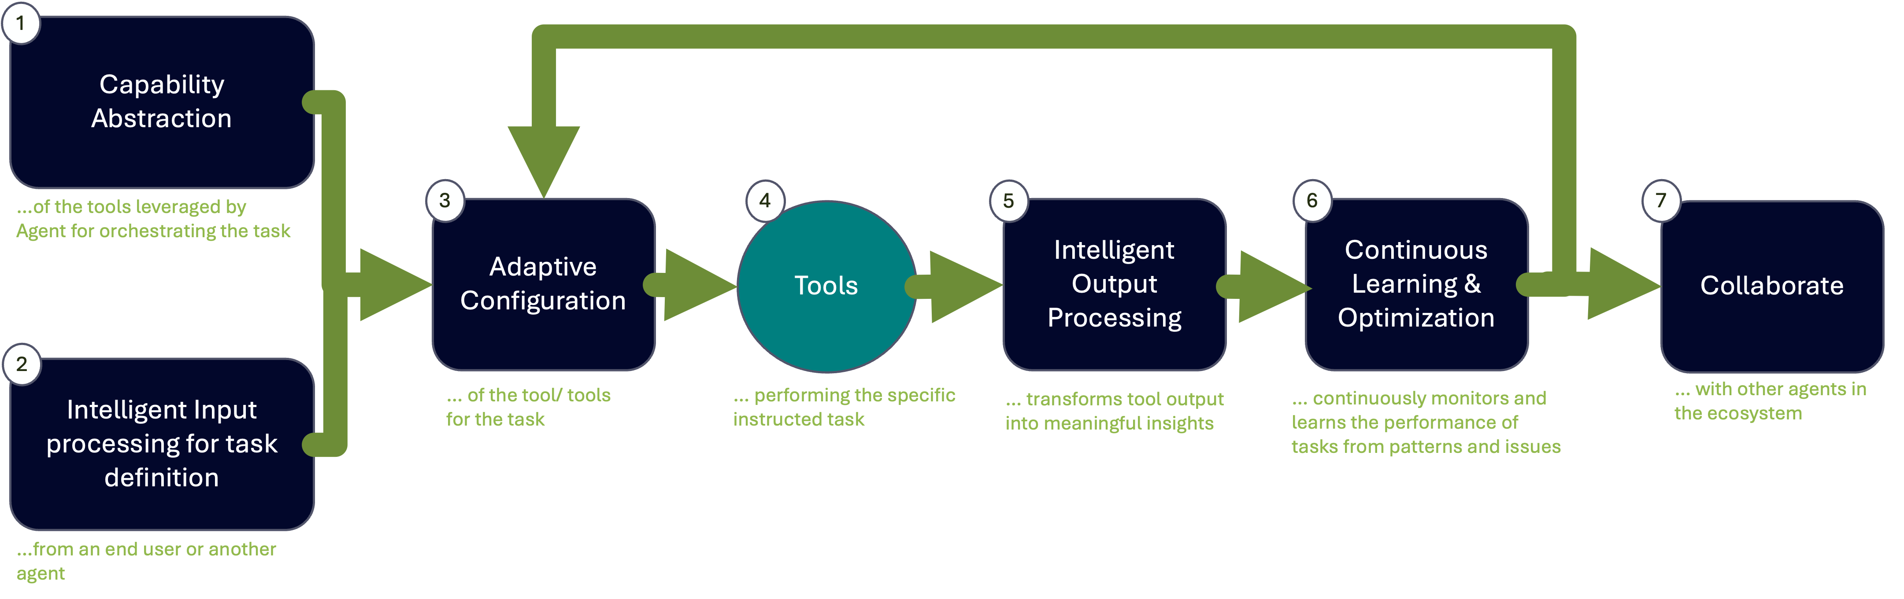
Intelligent Data Ingestion Agent (IDIA)
This agent wraps around Fivetran, a powerful ETL tool, to provide intelligent, context-aware data ingestion capabilities.
1
2
3
4
5
6
Capability Abstraction | Intelligent Input Processing | Adaptive Configuration | Intelligent Output Processing | Continuous Learning & Optimization | Collaborate
Knowledge Repository: Fivetran's capabilities, supported connectors, APIs, and best practices Connector Registry: Detailed information about each connector's schema, parameters, limitations, and usage patterns Capability Mapping: A structured representation of what Fivetran can and cannot do, allowing for rapid capability matching | Natural Language Understanding to interpret user requests Categorization of request through Intent Classification Identification of data sources, destination targets, and parameters Intelligent identification of the relationship of source tables and suggest tables for ingestion User Profile Integration: Adapting to user expertise level and preferences . | Intelligent selection and sequencing of Fivetran API calls Automated generation of optimal configuration parameters Smart recommendations for source-to-destination field mappings Intelligent scheduling based on data volume and freshness requirements Error Handling Strategy Custom Connectors: Intelligent build using Connector SDK and Rest APIs. | Operational Status Interpretation: Translating technical logs into business-relevant insights Performance Analytics Anomaly detection in data ingestion processes Business Impact Assessment Visualization Generation: Creating visual representations of ingestion health and status | Usage Pattern Analysis: Learning from historical agent interactions Performance Monitoring: Tracking ingestion job success rates and durations Feedback Integration: Incorporating explicit and implicit user feedback Knowledge Base Updating: Automatically refreshing Fivetran capability information Self-Improvement: Refining recommendation algorithms based on outcomes | Agent Communication Protocol: Structured format for inter-agent messaging Event Publishing: Broadcasting of significant events to interested agents Service Discovery: Mechanism to identify and interact with other platform agents Task Delegation: Framework for assigning sub-tasks to specialized agents Collective Learning: Sharing insights gained across the agent ecosystem

Slide 7

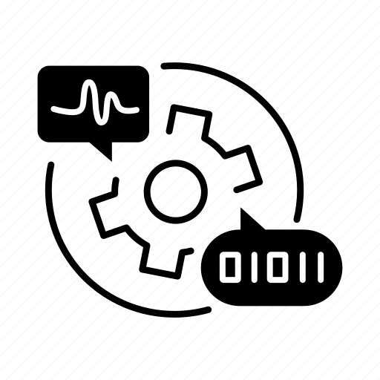

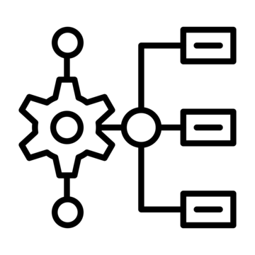

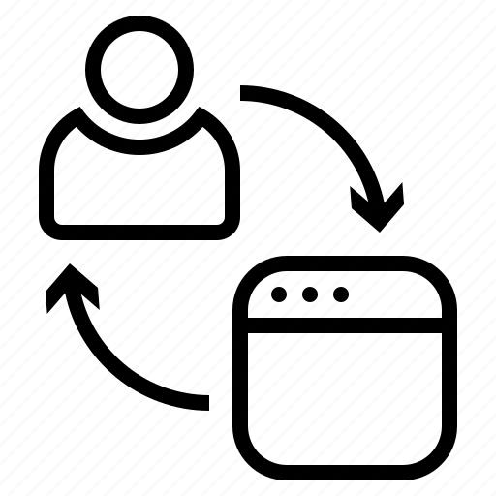
Technical Implementation Architecture
Vector Knowledge Store
NLP Engine
API Integration Layer
Workflow Engine
Monitoring & Analytics
Agent Communication Bus
Embeddings of Fivetran documentation, API references, and best practices
Semantic search capabilities for rapid knowledge retrieval
Regular update mechanism to stay current with Fivetran releases
Fine-tuned LLM for data integration domain
Specialized models for technical parameter extraction and validation
Few-shot learning capabilities for adapting to organization-specific terminology
Authentication and authorization management
Rate limiting and request optimization
Response caching and connection pooling
Error handling and retry logic
State management for multi-step ingestion processes
Parallel execution of independent tasks
Checkpoint and recovery mechanisms
Long-running operation management
Real-time metrics collection from Fivetran APIs
Performance benchmarking against historical data
Predictive analytics for resource planning
Anomaly detection for early issue identification
Event-driven architecture for inter-agent communication
Standardized message formats for agent interoperability
Prioritization mechanisms for urgent notifications
Audit logging of all inter-agent interactions

Slide 8
Implementation Timeline
Phase 1
Phase 2
Phase 3
1.5 months
2 months
1 month
Establish core knowledge base for Fivetran capabilities
Implement basic NLU for ingestion requests
Create fundamental API integration framework
AI based Relationship insights of Source data model
Implement support for top 10-15 most common connectors
Develop basic schema mapping recommendations
Create initial monitoring and reporting capabilities
AI based build for custom connectors using SDK and API
Test with real user scenarios
Refine NLU capabilities based on test results
Non-Fivetran Data movement over FTP to a target data model
Implement basic error handling and recovery
Objectives
Vector database of Fivetran connector documentation
Basic intent classification model
Core API integration layer with authentication
Entity relationship between data assets in the source
Functional connector setup and configuration
Basic schema mapping functionality
Simple monitoring dashboard
Validated agent for production use
Support FTP sources
Initial user documentation
Simple training module for citizen users
Deliverables

Slide 9
Execution Plan – Phase 1
Week | Activity
Week 1 | Architecture finalization & data flow design
 | Break down into backend, AI, FE modules
Week 2 | Setup PoC Azure environment + repos
 | Create base backend & frontend code
 | Setup DB schema (App DB)
Week 3 | Populate Fivetran ingestion knowledge base
 | Setup & test vector DB
 | Design table relationship model from catalog
Week 4 | Integrate Fivetran API
 | Define NLU intent classes + GenAI prompt templates
Week 5 | Implement GenAI call to extract metadata from a sample source
 | API + vector retrieval integration
 | Connect FE to ingestion API
Week 6 | Integration testing
 | Internal dry-run of ingestion flow
 | Phase 1 demo & documentation

Slide 10
Execution Plan – Phase 2
Week | Activity
Week 7-8 | Add support for top 10 Fivetran connectors
 | Design tables mapping prompt/template
Week 9-10 | Integrate tables mapping output into FE
 | Logging of job status/errors
 | SSO Integration
Week 11-12 | Build GenAI-assisted flow to auto-generate Fivetran SDK-based connector
 | Add Fallback Error Messaging
Week 13 | Internal testing of 10 connector flows
 | Monitoring Dashboard UX
Week 14 | QA testing + dry run
 | UI/UX Refinements
Week 15 | Feedback incorporation
 | Final round of deployment tests
 | Phase 2 wrap-up demo & documentation

Slide 11


Delivery Pod Structure
AuxoAI Team
ADI Team
Project Manager
Platform Team
ML Engineer
ML Engineer
Back End Developer
Auxo Team
Back End Developer
ADI Team
Front End Developer
Data Engineer
Data Domain Teams
Data Infra SME
QA Engineer

Slide 12
Thank You!

Slide 13



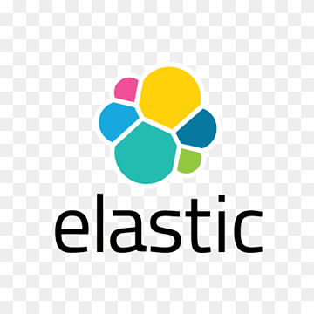
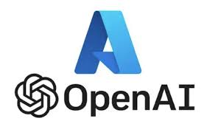

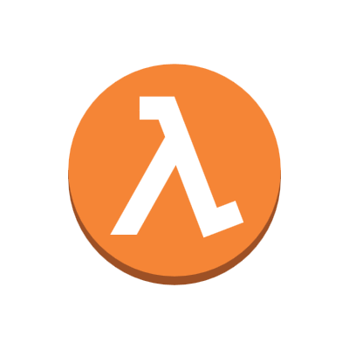

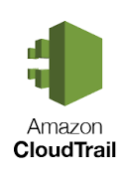
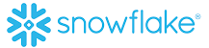

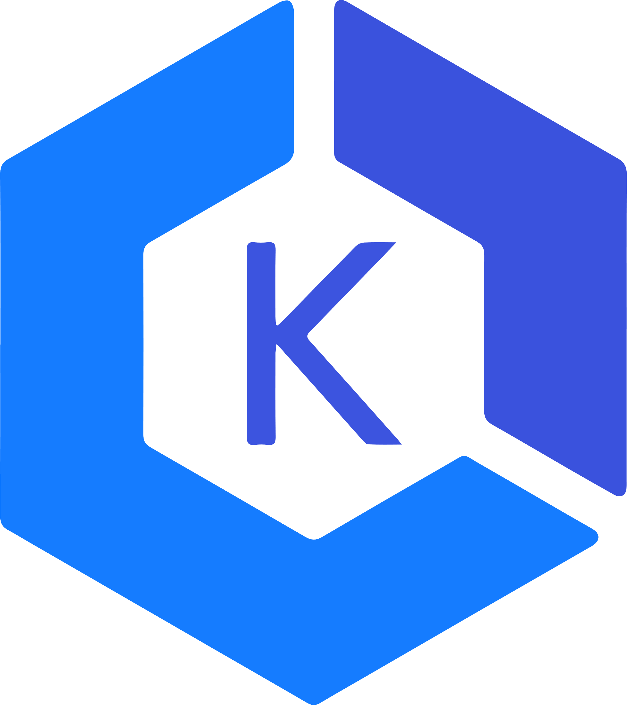
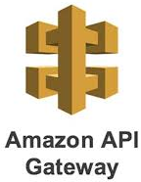



Gen AI Architecture Process View : Converse With Data
Enterprise Data Catalog
Fail
2.1
ConverseWithData App
User accessible table info
Single Sign On
Fetch the Metadata, Data dictionary
1
Authentication & Authorization
User query (Natural Language)
Data(RBAC)
Access Control
Check
Vector store
User Login
User
2
3
Response
(Data Sharing)
4
Permit
Metadata Info + User text
8
Gen AI based
Query Generation
Generate SQL Query
LLM
Text
Charts
5
Tech Stack
Enterprise Data Catalog
7
Data Availability
Optimized Query Execution
6
Curated Layer
Non-Curated Layer
React Frontend
Web Application Lambda
Data Virtualization
Fast API
Query complexity check
K8s
Notify on execution progress
13
Notes:
Flow
User logs into the interface using SSO and is authenticated using the AWS IAM policy
User provides the prompt in natural language in the chat interface. 2.1 : The user information would be provided to get the list of datasets that the user has access to
Once the prompt is given, the application retrieves the list of tables (metadata info) that the user has access to, from Enterprise Data catalog AWS IAM policy is leveraged to check the list of databases/tables the user has access to. If there are no tables, the user is notified with the error message
Based on this list, the data dictionary for the relevant tables is read from Vector DB and SQL query is generated from the user prompt using the underlying LLM model in Bedrock
Once the SQL query is generated, the agent check for the data availability in curated layer or non-curated layer. The Query is assessed for the complexity using a SQL parser and estimate execution time based on historical data and database stats. We set predefined complexity thresholds and notify users if their queries exceed these limits, offering alternatives for more efficient insights like offering pre-curated data or simplified query alternatives.
The execution requests go to the federated query or data virtualization layer for processing Use Athena for Federation: Run optimized queries on Redshift, Oracle, SAP Hana. Optimization Techniques: Apply indexing, partitioning, and caching for better performance.
The resultant data of the query is converted to the form of text and chart visualization.
After the output is generated, the application generates the final response. The Response is shared to the user through chat interface

